Slide 2
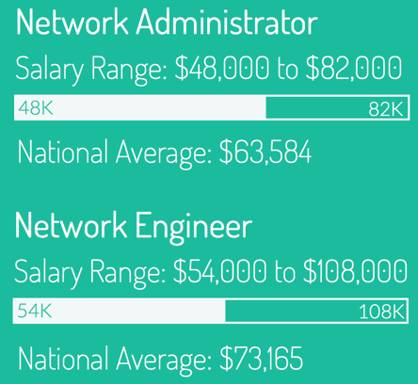
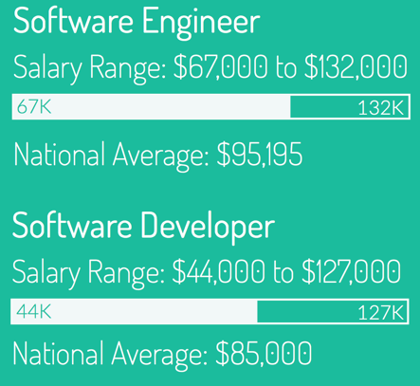
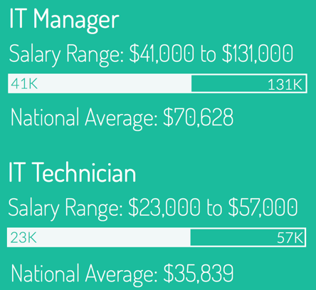
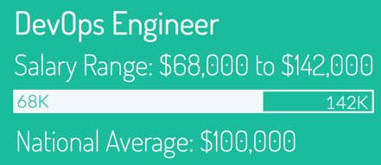
Linux Salary Guide

Slide 4
Linux is a core skill for all IT professionals.

Slide 5
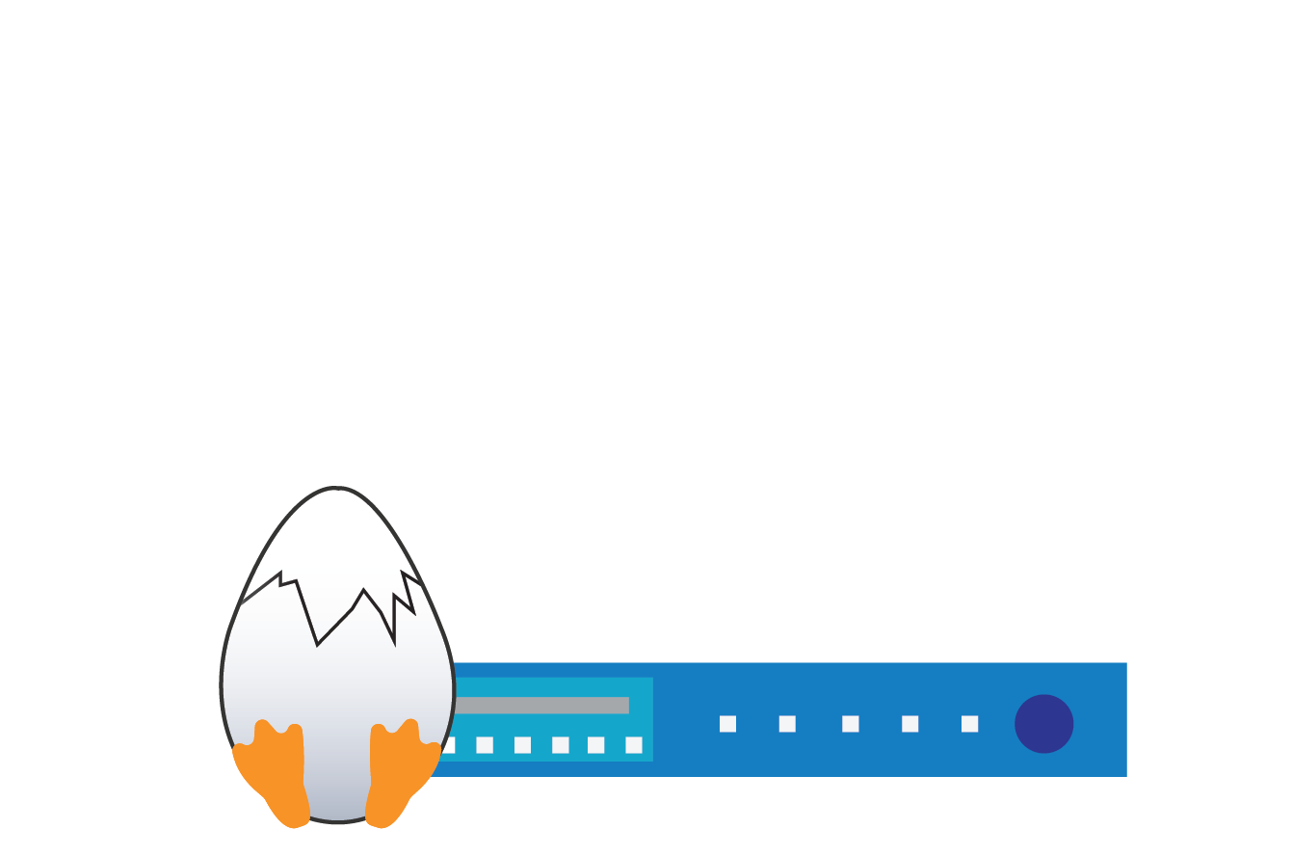
NDG Linux Courses Offered to Cisco Networking Academies
NDG Linux Unhatched
NDG Linux Essentials
NDG Linux 1
NDG Linux 2
Notes:
so what? if you take the ipod example and apply it to us, “everything you need to become a Linux expert in your browser window

Slide 6
Easy to Use
Delivered on the Networking Academy learning platform
Lectures, content, labs, assessments, and classroom aids
Real command-line experience through NDG virtual terminal

Slide 7
Easy to Get Started
No Special Training
No Lab Equipment
Free To Instructors

