Slide 1
Cisco Networking Academy and NDG Present Give Students Limitless Opportunities with Linux Courses
Grace Bixby
Project Manager // Network Development Group

Slide 2
Who is NDG?
Focus: Serving others by helping with job skills
Mission: Help academic institutions teach IT
Develop instructional content aligned to jobs
Working with academia 15+ years

Slide 3
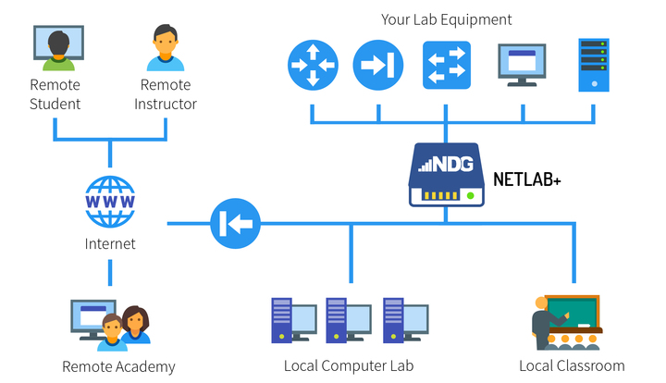
NETLAB+ A solution schools host or NDG provides as a service.
Notes:
Netlab+ is a software product loaded on an appliance that academic institutions use to host Cisco equipment and VMware servers.
This is important because Cisco requires equipment to teach Cisco courses
Previously learners and instructors could only access the lab equipment in the classroom
They can now learn from anywhere, the local classroom, computer lab or anywhere on the internet.
Students can get more hands on access to lab equipment.
It also allows for hybrid and distance learning models, where a learner can be in one location and the instructor in another.

Slide 4
NETLAB+ Features
Remote Access
Lab Content
Scheduler
Proactive Resource Awareness
Automation and Assessment
System Administration

Slide 5
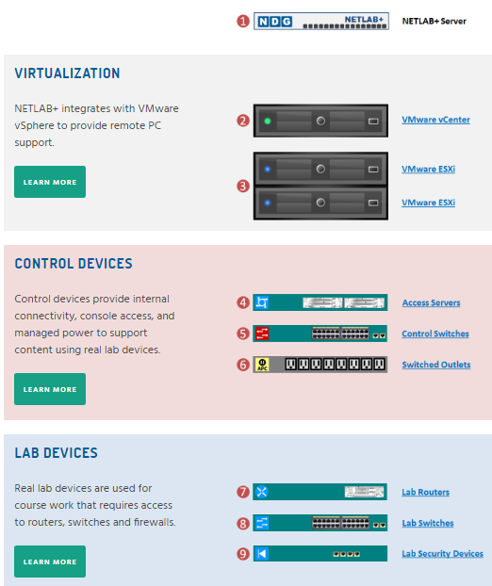
NETLAB+ VE
NETLAB+ hardware replaced with virtual appliance
Virtual appliance will “run” on the vCenter server
Two options for new customers:
Option 1: vCenter server and NETLAB+ VE
Option 2: NETLAB+ VE

Slide 6
Why Linux?

Slide 7
¡Linux está en todas partes!

Slide 8
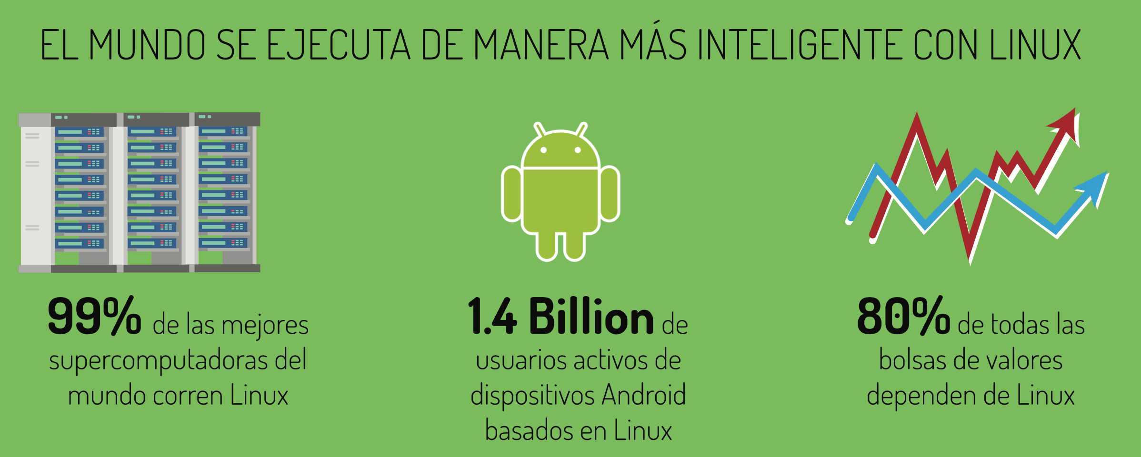

Slide 12
Companies That Use Linux

Slide 13
Interesting Opportunities for Linux Professionals
Notes:
http://electrek.co/2016/05/18/take-a-drive-bill-gates-tesla-model-x/
https://blogs.technet.microsoft.com/windowsserver/2015/05/06/microsoft-loves-linux/

Slide 14
Example: Cisco wants Linux professionals too!

Slide 15
Linux Skills Are In Demand

Slide 16
Linux Skills Are In Demand
97% of hiring managers plan to hire Linux talent within 6 months
88% of hiring managers say it is difficult to find qualified Linux talent
90% of professionals say that knowing Linux has advanced their careers
Source: 2015 Linux Jobs Report (Linux Foundation and Dice)

Slide 17
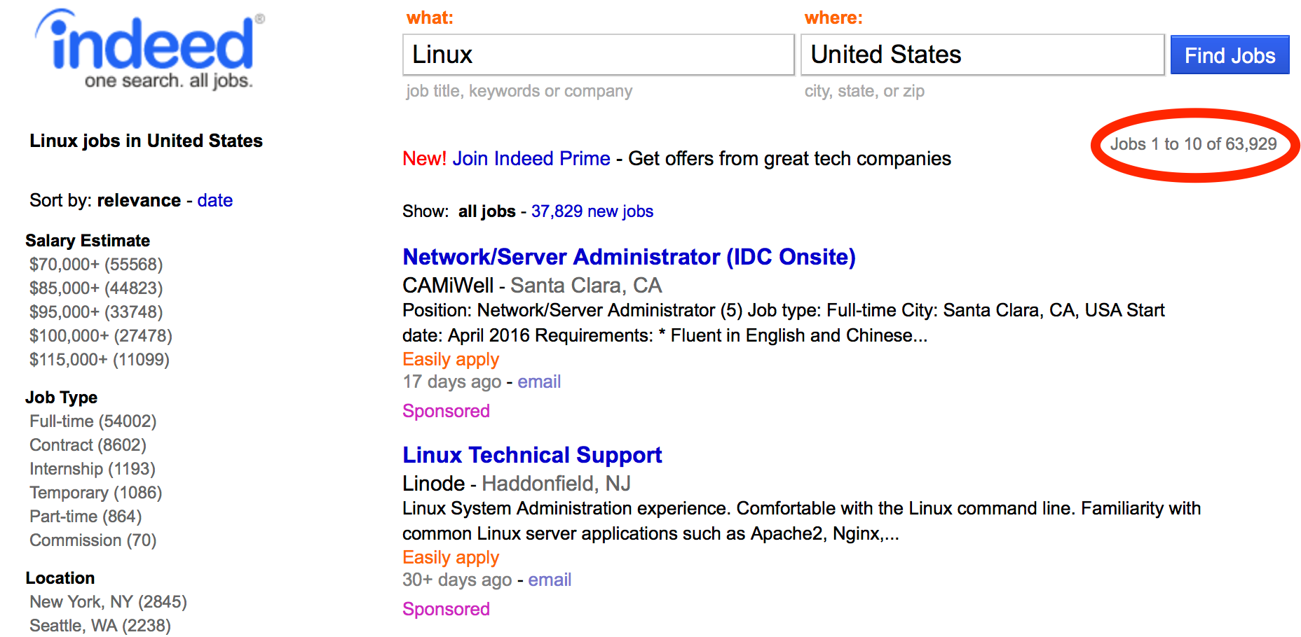
Linux Skills Are In Demand
Indeed.com Job Search Keyword = Linux
Jobs | Country
76,594 | China
63,929 | USA
19,867 | Japan
19,030 | India
10,965 | England
8,576 | France
8,362 | Germany
1,255 | Australia
1,187 | Mexico

Slide 18
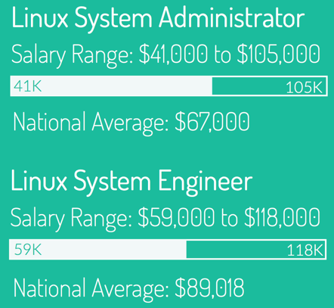
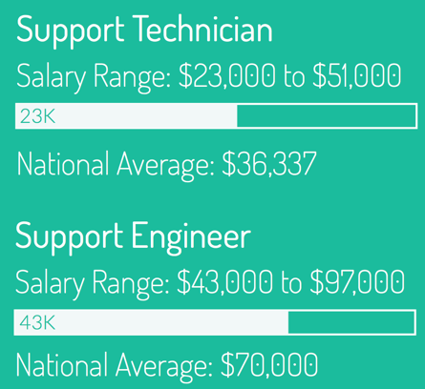
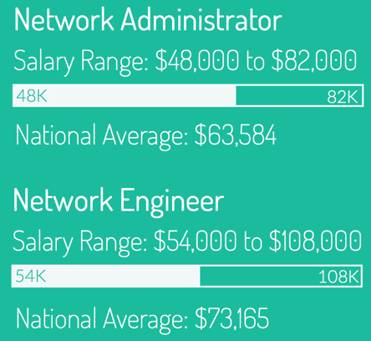
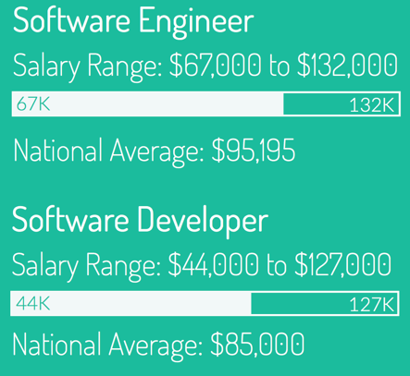
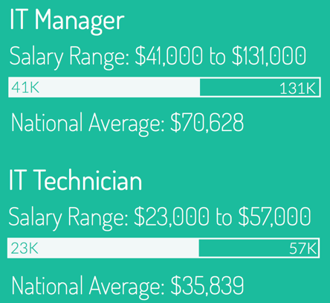
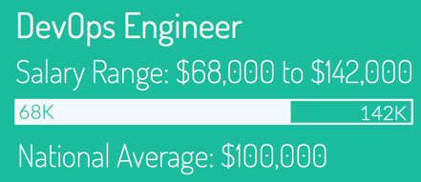
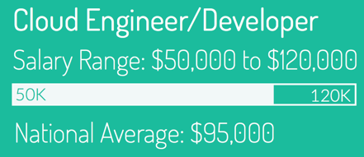
Linux Salary Guide

Slide 20
Linux is a core skill for all IT professionals.

Slide 21
NDG Linux Courses

Slide 22
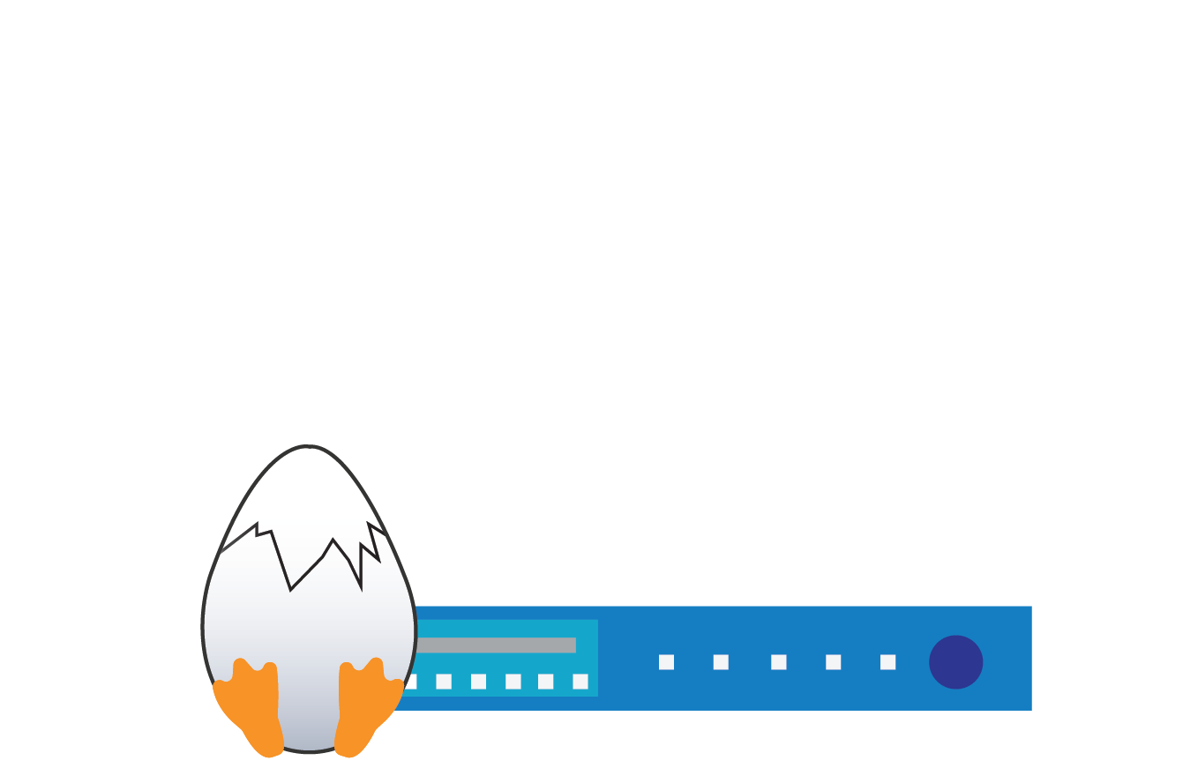
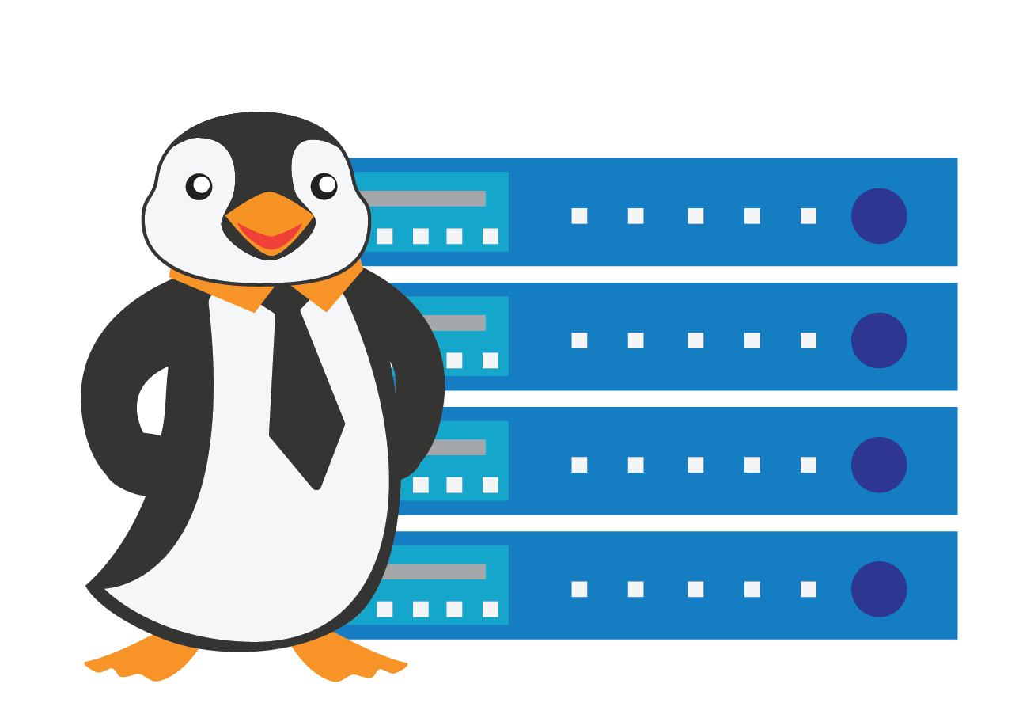
NDG Linux Courses Offered to Cisco Networking Academies
NDG Linux Unhatched
NDG Linux Essentials
NDG Linux 1
NDG Linux 2

Slide 23
Easy to Use
Delivered on the Networking Academy learning platform
Lectures, content, labs, assessments, and classroom aids
Real command-line experience through NDG virtual terminal

Slide 24
Certifications Help Students Stand Out
44% of hiring managers are more likely to hire a candidate with Linux certification.

Slide 25
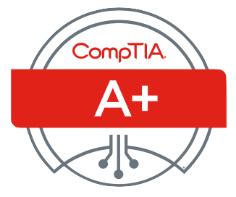
Certifications Help Students Stand Out
COURSE TITLE | CERTIFICATION EXAM ALIGNMENT
NDG Linux Unhatched | CompTIA A+ (Linux Knowledge)
NDG Linux Essentials | Linux Essentials Professional Development Certificate
NDG Linux Series | LPIC-1: Linux Server Professional Certification
 | CompTIA Linux+ Powered by LPI

Slide 27
Learn By Doing!
“I hear and I forget.
I see and I remember.
I do and I understand.”
Confucius

Slide 28
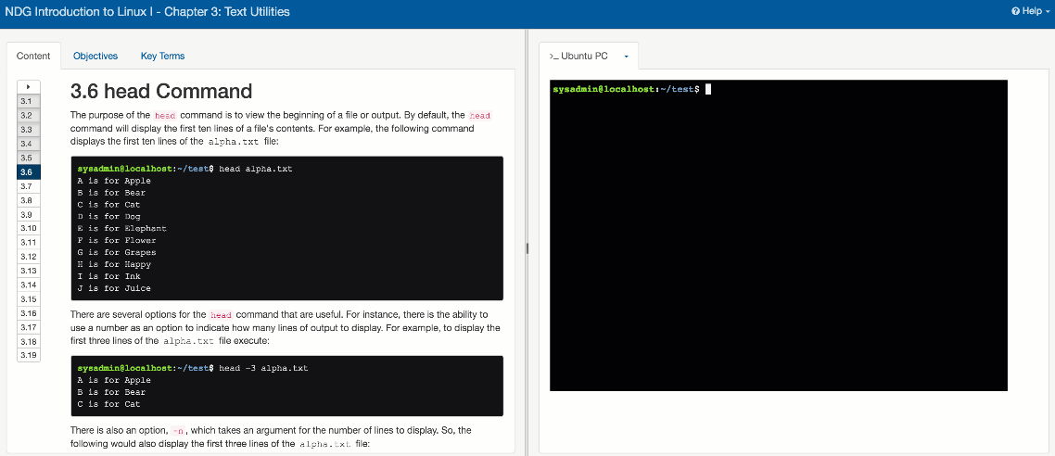
Course Content with Virtual Machine

Slide 29
Easy to Get Started
No Special Training
No Lab Equipment
Free To Instructors

Slide 30
Economical
Course Title | Cost to Instructors | Cost to Students
NDG Linux Unhatched | FREE | FREE
NDG Linux Essentials | FREE | FREE
NDG Linux I | FREE | $39.95*
NDG Linux II | FREE | $39.95*
* Paid by the learning institution or the individual student

Slide 31
NDG Linux Courses

Slide 32
NDG Linux Essentials
Aligns to LPI Linux Essentials Professional Development Certificate
Designed to be a Full Semester Course
With lectures, content, labs and assessments
Sixteen (16) Chapters
Thirteen (13) Lab Exercises
4 Challenge Labs
Assessments
Chapter, Midterm and Final
Languages: English

Slide 33
NDG Linux Essentials
Aligns to LPI Linux Essentials Professional Development Certificate
Designed to be a Full Semester Course
With lectures, content, labs and assessments
Sixteen (16) Chapters
Thirteen (13) Lab Exercises
4 Challenge Labs
Assessments
Chapter, Midterm and Final
Languages: English

Slide 34
NDG Linux I
Aligns to LPI LPIC-1 (Exam 1 of 2)
Designed to be a Full Semester Course
With lectures, content, labs and assessments
Higher level of rigor than Linux Essentials
27 chapters
24 lab exercises
Assessments
Chapter, Midterm and Final
Languages: English

Slide 35
NDG Linux II
Aligns to LPI LPIC-1 (Exam 2 of 2)
Designed to be a Full Semester Course
With lectures, content, labs and assessments
19 chapters
19 lab exercises
Assessments
Chapter, Midterm and Final
Languages: English

Slide 36
NDG Linux Unhatched
Aligned to CompTIA A+
6-8 Hours
1 Chapter
1 Assessment
Linux Starting Point
Languages: English, Spanish

Slide 37
Free, 8 hour module to teach basics of Linux aligned to A+ certification.

Slide 38
What’s covered on the CompTIA A+ 900 series?
Basic Linux Commands
ls
grep
cd
shutdown
pwd
passwd
mv
Cp
rm
chmod
chown
iwconfig/ifconfig
ps
su/sudo
apt-get
vi
dd

Slide 39
Available in Cisco Networking Academy

Slide 40
Translation First Steps

Slide 41
Spanish Translation – First Steps
Linux Unhatched – Spanish Trial
Designed for Feedback
Working with American Digital
Next Steps:
Linux Essentials – Spanish
How do we scale?

Slide 42
NDG Linux Unhatched Disponible en Español https://www.netacad.com/es/courses/ndg-linux-unhatched/

Slide 43
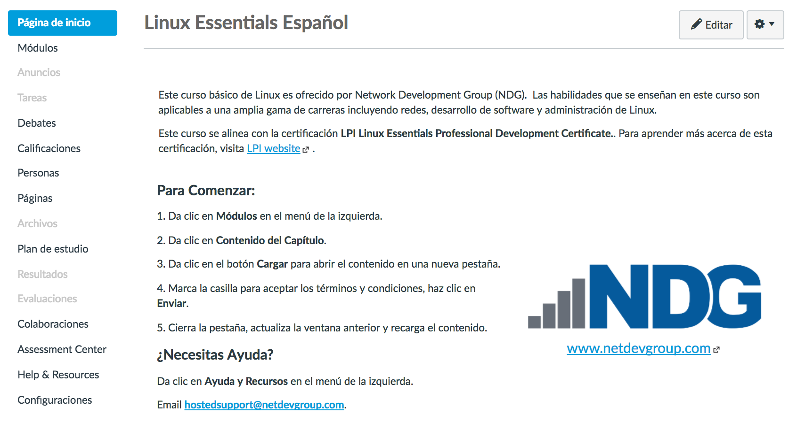
NDG Linux Essentials Demo en Español https://www.netacad.com/es/self-enroll/

Slide 44
Muchas Gracias Obrigada Thank You

