Slide 1
NDG Linux Series

Slide 2
NDG Linux I
Aligns to LPI LPIC-1 (Exam 1 of 2)
Designed to be a Full Semester Course
With lectures, content, labs and assessments
Higher level of rigor than Linux Essentials
27 chapters
24 lab exercises
Assessments
Chapter, Midterm and Final
Languages: English

Slide 3
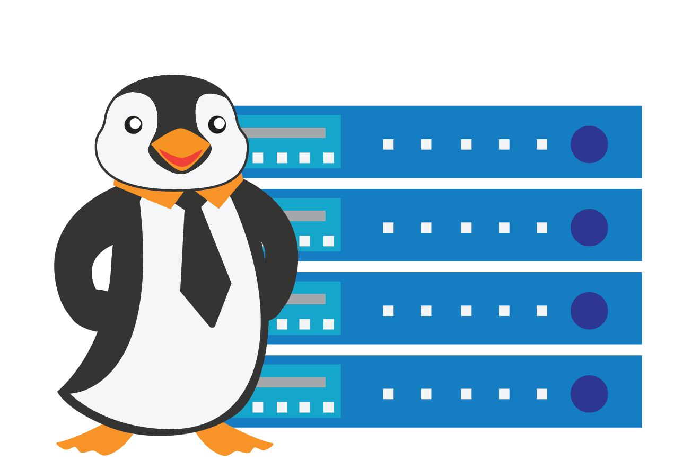
NDG Linux II
Aligns to LPI LPIC-1 (Exam 2 of 2)
Designed to be a Full Semester Course
With lectures, content, labs and assessments
19 chapters
19 lab exercises
Assessments
Chapter, Midterm and Final
Languages: English

